Slide 1
Term 3 week 3 Lesson 1
Aqueous solutions of ionic compounds

Slide 2
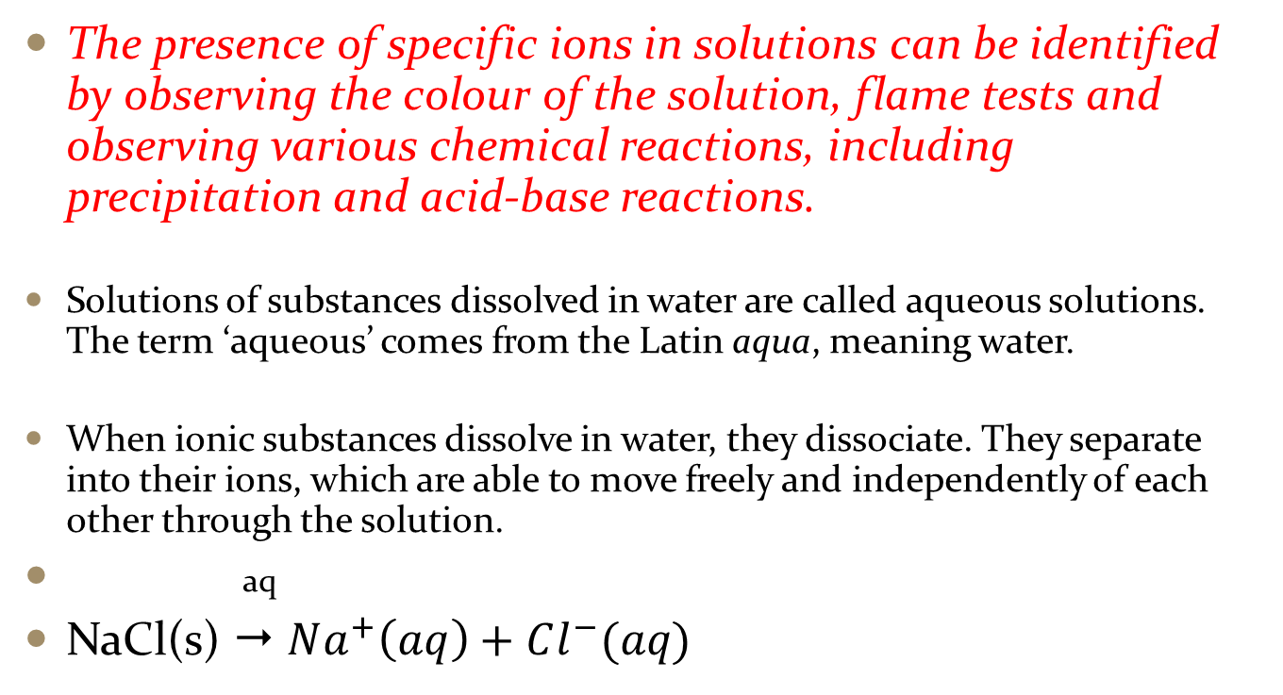
The presence of specific ions in solutions can be identified by observing the colour of the solution, flame tests and observing various chemical reactions, including precipitation and acid-base reactions.
Solutions of substances dissolved in water are called aqueous solutions. The term ‘aqueous’ comes from the Latin aqua, meaning water.
When ionic substances dissolve in water, they dissociate. They separate into their ions, which are able to move freely and independently of each other through the solution.
aq
NaCl(s)  $Na^{+}\left(aq\right)+Cl^{−}(aq)$

Slide 3
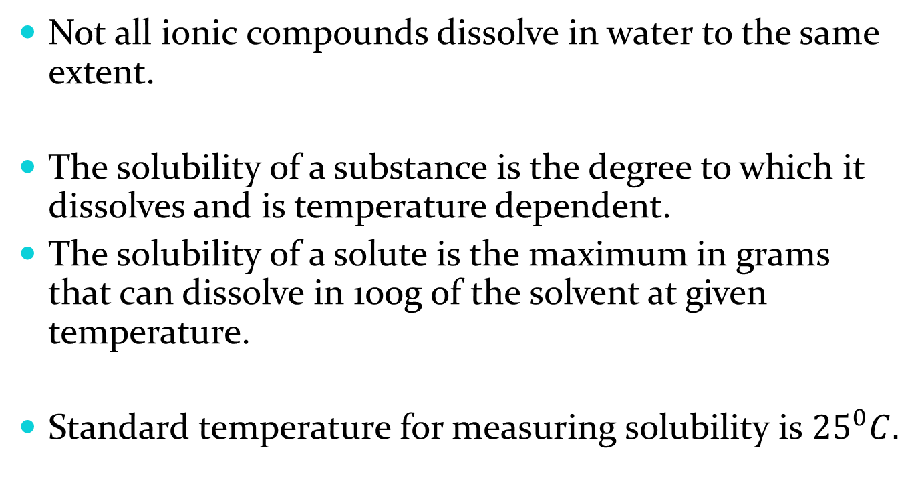
Not all ionic compounds dissolve in water to the same extent.
The solubility of a substance is the degree to which it dissolves and is temperature dependent.
The solubility of a solute is the maximum in grams that can dissolve in 100g of the solvent at given temperature.
Standard temperature for measuring solubility is ${25}^{0}C.$

Slide 4
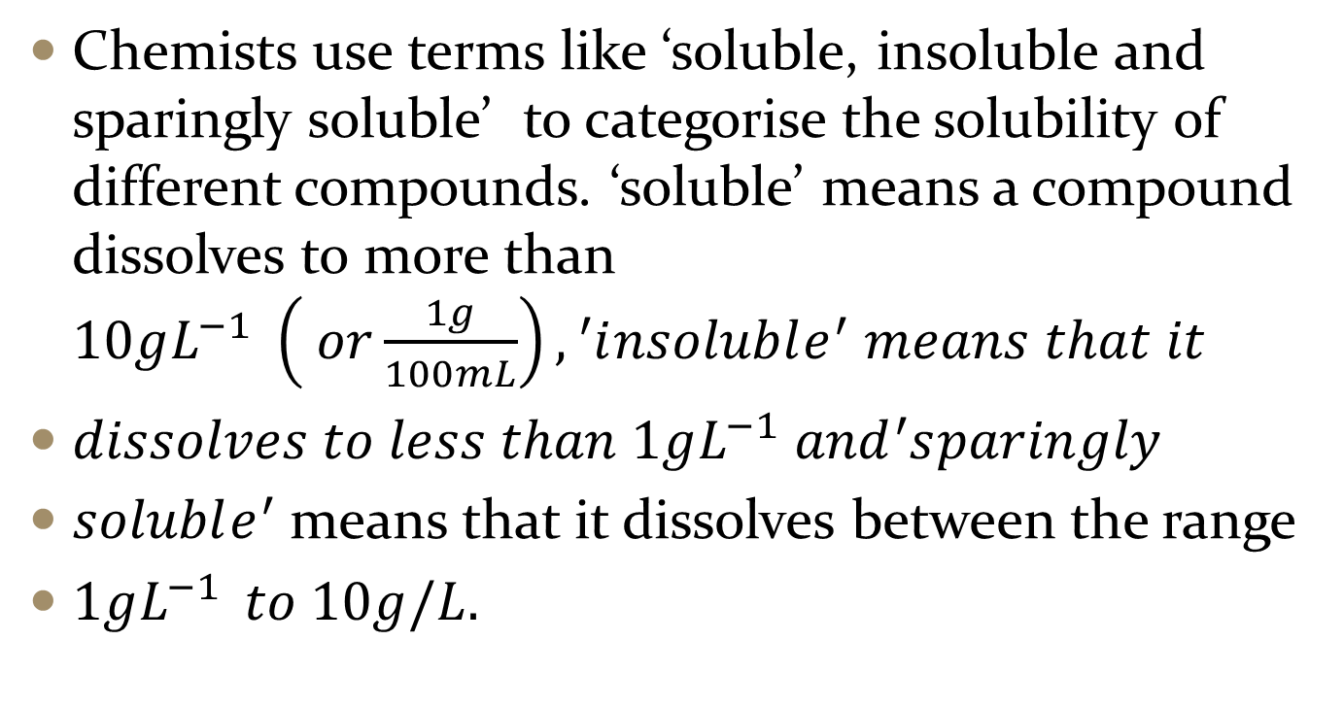
Chemists use terms like ‘soluble, insoluble and sparingly soluble’ to categorise the solubility of different compounds. ‘soluble’ means a compound dissolves to more than $10gL^{−1} \left( or\frac{1g}{100mL}\right),{}_{}^{′}insoluble^{′} means that it$
$dissolves to less than 1gL^{−1} and{}_{}^{′}sparingly$
$soluble^{′}$means that it dissolves between the range
$1gL^{−1 } to 10g/L.$

Slide 5
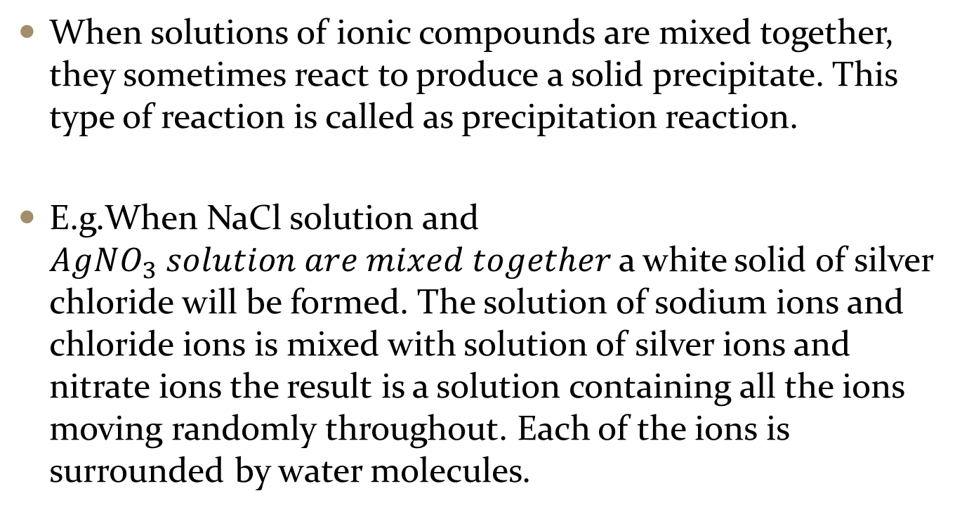
Precipitation reactions
When solutions of ionic compounds are mixed together, they sometimes react to produce a solid precipitate. This type of reaction is called as precipitation reaction.
E.g.When NaCl solution and $AgNO_{3} solution are mixed together$a white solid of silver chloride will be formed. The solution of sodium ions and chloride ions is mixed with solution of silver ions and nitrate ions the result is a solution containing all the ions moving randomly throughout. Each of the ions is surrounded by water molecules.

Slide 6
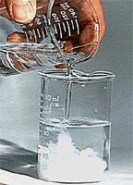
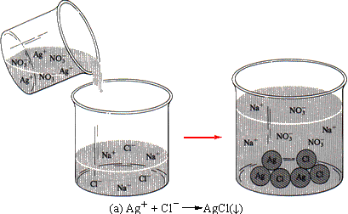
The silver and chloride ions are more strongly attracted to each other than they are to the water , they can cluster together in groups to form a solid. This will be precipitated out.

Slide 7
Look at the ionic equation in page: 305 NC
Predicting precipitation
When mixing solution which contains known cations and anions chemists have experimentally which compounds are soluble and which form a precipitate. Sometimes when precipitate forms it does not settle to the bottom but forms suspension and the mixture look
cloudy.

Slide 8
Applying solubility data
Precipitation reactions are useful for finding out a particular cation or anion is present. E.g. Chemists use precipitation reactions to test lead or cadmium in water supplies. Precipitation reaction can also be used to remove unwanted substances from water.
Homework
Complete Q’s 1, 2,5, 7 and 9 from page: 140 -141

